Slide 1
End-to-End CI/CD Pipeline Using Jenkins, Docker, and AWS EKS
Automated Build, Test, Containerization & Kubernetes Deployment

Slide 2
Project Objective
Create a production-style automated pipeline to reduce manual work, speed up deployments, and ensure reliable, scalable delivery of applications using Jenkins, Docker, and AWS EKS.

Slide 3
Tools & Technologies Used
Git: Version control for source code and collaboration.
Maven: Build and package the Java application automatically.
Jenkins: Automates CI/CD pipeline and triggers builds on code changes.
Docker: Containerizes the application into portable images.
Kubernetes (EKS): Orchestrates containers and manages deployment and scaling.

Slide 4
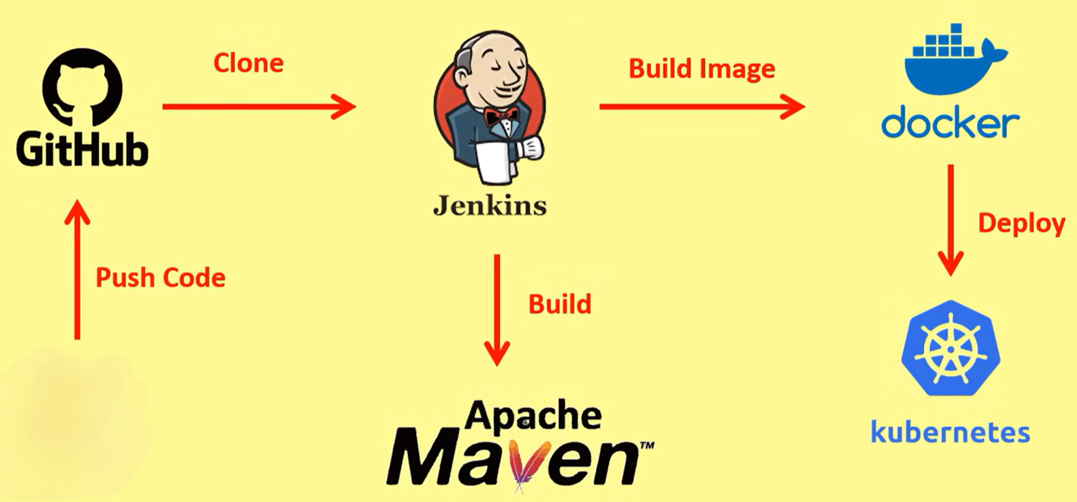
CI/CD Workflow

Slide 5
CI/CD Pipeline Steps
Clone code from GitHub
Maven build (compile & package)
Docker image creation (Dockerfile)
Push image to Amazon ECR
Deploy/update application in EKS
Expose service through Load Balancer

Slide 6
Where This Project Is Used
Teams that release software frequently and need automation.
Microservice-based applications running in containers.
Cloud-native services in e-commerce, banking, healthcare, fintech, and SaaS.
Environments that require scalable, zero-downtime deployments.

Slide 7
Real-World Example
E-commerce website (e.g., Amazon/Flipkart): Developers push changes daily → Jenkins builds and creates Docker images → ECR stores images → EKS deploys new version using rolling updates → Customers experience no downtime while features are released continuously.

Slide 8
Advantages
Fully automated deployments and faster release cycles
Scalable Kubernetes environment with Auto Scaling
Zero-downtime releases via rolling updates
Improved reliability and repeatability in deployments

Slide 9
Possible Improvements
Add Monitoring & Alerts:
Integrate tools like Prometheus, Grafana, or CloudWatch to track application and cluster health.
Enable Auto-Rollback:
Automatically revert to the previous stable version if a deployment fails.
Add Automated Testing:
Include unit and integration tests in the pipeline to catch issues early.

Slide 10
Conclusion
This project demonstrates practical DevOps skills—CI/CD automation, containerization, and Kubernetes orchestration—delivering reliable, scalable deployments on AWS.

